Slide 1

FigmAI: Transforming Design to Code with Generative AI
Bridging the gap between design and development with intelligent agents

Slide 2

The Design-to-Code Challenge
Current Landscape
Designers and developers work in separate ecosystems, leading to:
Inconsistent implementation of designs
Lengthy development cycles
Communication breakdowns between teams
Increased technical debt over time
Our solution transforms this fragmented workflow into a seamless process, reducing friction and accelerating production.

Slide 3



FigmAI: Solution Overview
A powerful AI-driven platform that transforms Figma designs into production-ready React code
Figma API Integration
Multi-Agent Processing
React Component Output
Connects to your Figma account and extracts component designs, preserving all styling details and relationships
Processes designs through specialized AI agents that understand design patterns and translate them to code
Generates high-quality, maintainable React components that faithfully represent the original design

Slide 4

The Three-Agent Architecture
1
2
3
Figma Analysis Agent
Code Generation Agent
Testing & Refinement Agent
Specialized in parsing and understanding Figma's complex component structures, layer hierarchies, and design systems
Transforms design specifications into clean, optimized React code following modern development practices
Validates code output and refines based on human feedback to ensure quality and accuracy
Maps visual elements to semantic structures
Implements responsive behavior
Performs visual regression testing
Maintains accessibility standards
Implements feedback in subsequent iterations
Identifies reusable patterns and components
Creates component props and variants
Ensures cross-browser compatibility
Preserves design intention through metadata analysis

Slide 5

Proof of Concept Results
Key Achievements
Component Fidelity
Successfully translated complex Figma components with 95% visual accuracy
Code Quality
Generated clean, well-structured React code that passed standard linting and best practices
Developer Efficiency
Reduced implementation time by 70% compared to manual coding

Slide 6


Current Technical Implementation
Local LLM Implementation
Currently powered by Ollama running locally
Complete end-to-end workflow demonstrated
Processing time: 3-5 minutes per component
Technical Requirements
Figma API access for component extraction
React development environment
Sufficient local compute resources
Current performance is limited by local compute constraints, with significant potential for optimization with cloud-based LLMs.

Slide 7
Current Status & Roadmap
What We've Done
What's Next
Local LLM Implementation: Successfully integrated Ollama for local AI processing.
Cloud LLM Integration Transition to high-performance cloud LLMs to reduce generation time to under 30 seconds and enable parallel processing.
End-to-End Workflow: Demonstrated a complete pipeline from Figma design to React code.
Component Library Integration Implement automatic publishing to Storybook, integration with npm registry, and robust version control.
Initial Performance: Currently processing components in 3-5 minutes.
Key Features: Figma API integration, multi-agent processing, and React component output are functional.
Advanced Features Add support for animations and interactions, state management integration, and custom hook generation.
Enterprise Deployment Develop team collaboration features, enforce design system consistency, and integrate with CI/CD pipelines.

Slide 8
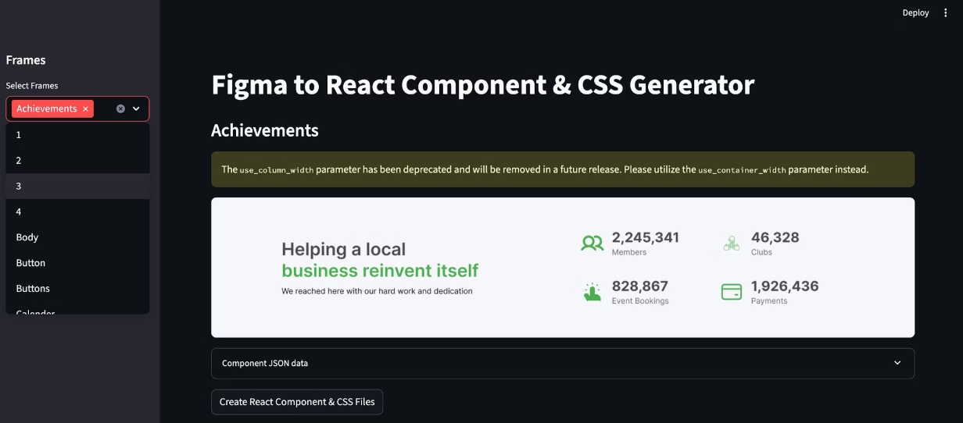
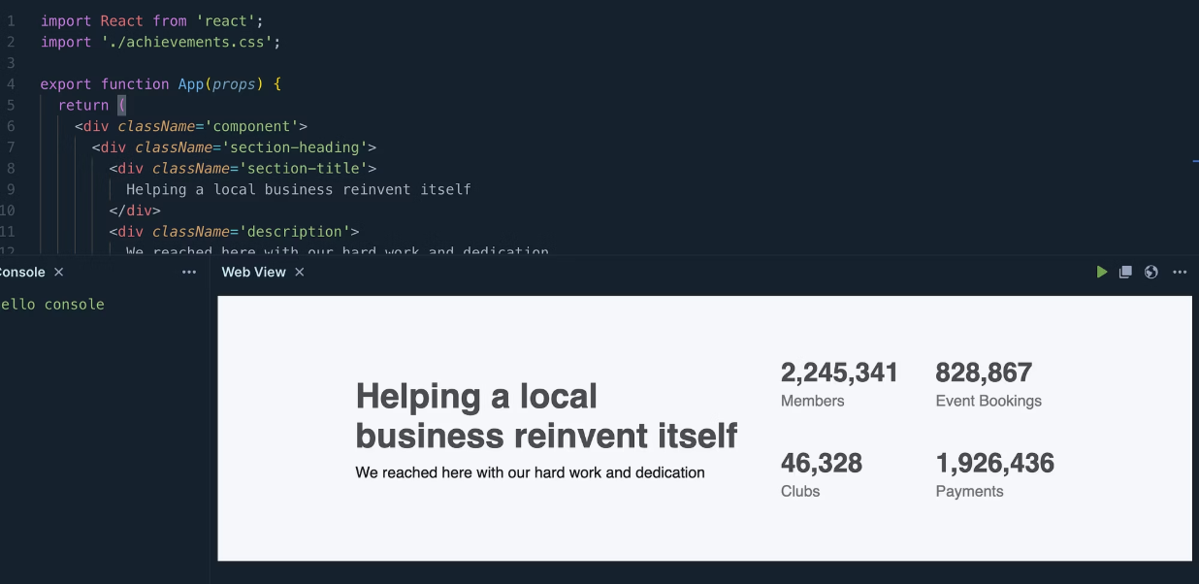
FigmAI in Action: Design to Code Visuals
See how FigmAI translates designs into clean, functional React code with high fidelity.
These visuals highlight the seamless transition from design concept in Figma, through our intelligent processing, to the final, production-ready React component.

Slide 9
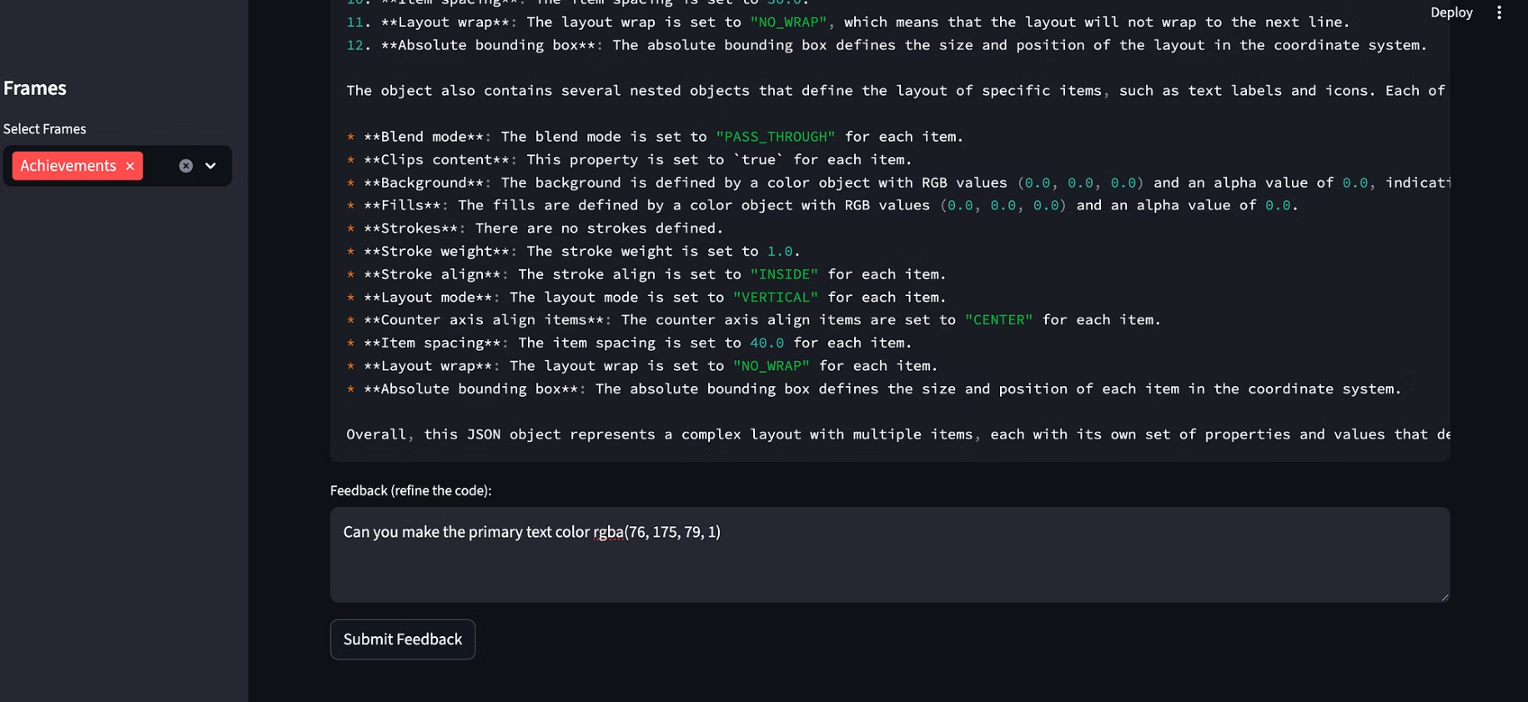
Iterative Refinement: Your Feedback, Our AI's Improvement
Refine & Repeat: Continue providing feedback until the component perfectly matches your design and functional requirements, ensuring pixel-perfect fidelity and optimal code quality.

